Slide 1
Chapter 1: roadmap
  1.1 what is the Internet?
  1.2 network edge
    end systems, access networks, links
  1.3 network core
    packet switching, circuit switching, network structure
  1.4 delay, loss, throughput in networks
  1.5 protocol layers, service models
  1.6 networks under attack: security
  1.7 history
Introduction
1-<number>

Slide 2

How do loss and delay occur?
packets queue in router buffers
packet arrival rate to link (temporarily) exceeds output link capacity
packets queue, wait for turn
packet being transmitted (delay)
A
B
packets queueing (delay)
free (available) buffers: arriving packets
dropped (loss) if no free buffers
Introduction
1-<number>

Slide 3
Four sources of packet delay
transmission
A
propagation
B
nodal
processing
queueing
d_{nodal} = d_{proc} + d_{queue} + d_{trans} + d_{prop}
d_{proc}: nodal processing
check bit errors
determine output link
typically < msec
d_{queue}: queueing delay
time waiting at output link for transmission
depends on congestion level of router
Introduction
1-<number>

Slide 4
Four sources of packet delay
transmission
A
propagation
B
nodal
processing
queueing
d_{nodal} = d_{proc} + d_{queue} + d_{trans} + d_{prop}
d_{trans}: transmission delay:
L: packet length (bits)
R: link bandwidth (bps)
d_{trans} = L/R
d_{prop}: propagation delay:
d: length of physical link
s: propagation speed (~2x10⁸ m/sec)
d_{prop} = d/s
d_{trans} and d_{prop}
very different
* Check out the online interactive exercises for more examples: http://gaia.cs.umass.edu/kurose_ross/interactive/
* Check out the Java applet for an interactive animation on trans vs. prop delay
Introduction
1-<number>

Slide 5
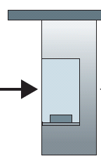

Caravan analogy
100 km
100 km
ten-car
caravan
toll
booth
toll
booth
cars “propagate” at
100 km/hr
toll booth takes 12 sec to service car (bit transmission time)
car ~ bit; caravan ~ packet
Q: How long until caravan is lined up before 2nd toll booth?
time to “push” entire caravan through toll booth onto highway = 12*10 = 120 sec
time for last car to propagate from 1st to 2nd toll both: 100km/(100km/hr)= 1 hr
A: 62 minutes
Introduction
1-<number>

Slide 6
Caravan analogy (more)
100 km
100 km
ten-car
caravan
toll
booth
toll
booth
suppose cars now “propagate” at 1000 km/hr
and suppose toll booth now takes one min to service a car
Q: Will cars arrive to 2nd booth before all cars serviced at first booth?
A: Yes! after 7 min, first car arrives at second booth; three cars still at first booth
Introduction
1-<number>

Slide 7


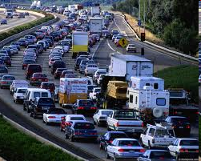
Queueing delay (revisited)
R: link bandwidth (bps)
L: packet length (bits)
a: average packet arrival rate
average queueing delay
traffic intensity
= La/R
La/R ~ 0: avg. queueing delay small
La/R -> 1: avg. queueing delay large
La/R > 1: more “work” arriving
than can be serviced, average delay infinite!
La/R ~ 0
La/R -> 1
* Check online interactive animation on queuing and loss
Introduction
1-<number>

Slide 8
“Real” Internet delays and routes
what do “real” Internet delay & loss look like?
traceroute program: provides delay measurement from source to router along end-end Internet path towards destination. For all i:
  sends three packets that will reach router i on path towards destination
  router i will return packets to sender
  sender times interval between transmission and reply.
3 probes
3 probes
3 probes
Introduction
1-<number>

Slide 9
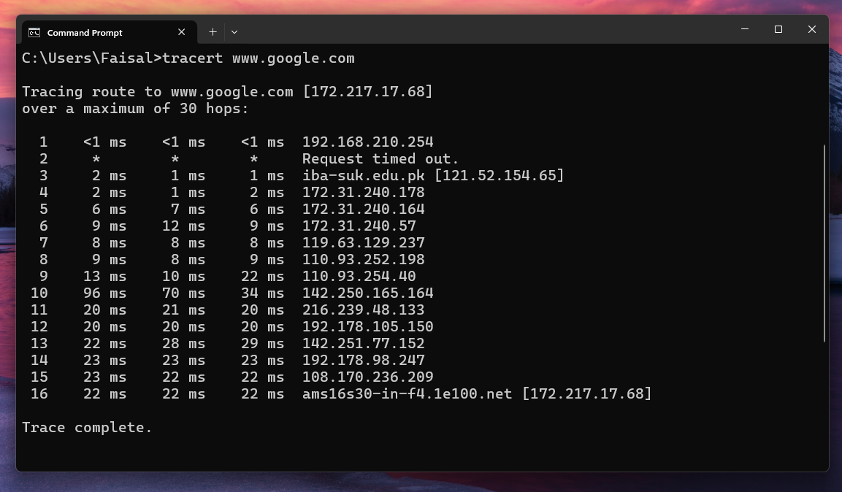
“Real” Internet delays, routes
Introduction

Slide 10
Key Observations
Initial Hops: The first few hops show very low latency, indicating local network infrastructure.
Timeout at Hop 2: This is common and not unusual. Routers or firewalls may be configured to ignore certain types of traffic, like ICMP packets used by traceroute.
Increase in Latency: Noticeable at hop 10, likely the international handoff point—moving from a regional ISP to a major backbone (possibly reaching Google's global infrastructure).
Consistent Latency: After the initial latency increase, delays stabilize as packets get closer to the destination within Google's network.
Introduction
1-<number>

Slide 11
Packet loss
queue (aka buffer) preceding link in buffer has finite capacity
packet arriving to full queue dropped (aka lost)
lost packet may be retransmitted by previous node, by source end system, or not at all
buffer
(waiting area)
A
packet being transmitted
B
packet arriving to
full buffer is lost
* Check out the Java applet for an interactive animation on queuing and loss
Introduction
1-<number>

Slide 12
Throughput
throughput: rate (bits/time unit) at which bits transferred between sender/receiver
  instantaneous: rate at given point in time
  average: rate over longer period of time
server, with
file of F bits
to send to client
link capacity
R_{s} bits/sec
link capacity
R_{c} bits/sec
server sends bits
(fluid) into pipe
pipe that can carry
fluid at rate
R_{s} bits/sec)
pipe that can carry
fluid at rate
R_{c} bits/sec)
Introduction
1-<number>

Slide 13
Throughput (more)
R_{s} < R_{c} What is average end-end throughput?
R_{s} bits/sec
R_{c} bits/sec
R_{s} > R_{c} What is average end-end throughput?
R_{s} bits/sec
R_{c} bits/sec
bottleneck link
link on end-end path that constrains end-end throughput
Introduction
1-<number>

Slide 14
Throughput: Internet scenario
per-connection end-end throughput: min(R_{c},R_{s},R/10)
in practice: R_{c} or R_{s} is often bottleneck
R_{s}
R_{s}
R_{s}
R
R_{c}
R_{c}
R_{c}
10 connections (fairly) share backbone bottleneck link R bits/sec
* Check out the online interactive exercises for more examples: http://gaia.cs.umass.edu/kurose_ross/interactive/
Introduction
1-<number>

Slide 15
Assignment
Describe the differences between guided and unguided media in network communication. Provide examples of each.
Answer should cover the distinction between guided media (e.g., twisted pair cables, coaxial cables, fiber optics) where signals are transmitted through physical materials, and unguided media (e.g., radio waves, microwaves, satellite communication) where signals travel through the air.
Introduction
1-<number>

